Slide 1
Minimum & Maximum Mode Operation
Minimum mode : When only one peocessor is required to be used i.e. main processor 8086/8088 and control signal required are also less then it is called as Minimum Mode
Minimum mode generates control signals itself.

Slide 2
There are not enough pins on the 8086 for bus control during maximum mode, so it requires addition of the IC 8288 external bus controller.
Maximum mode is used only when the system contains external coprocessors such as 8087 NDP and 8089 IOP.

Slide 3
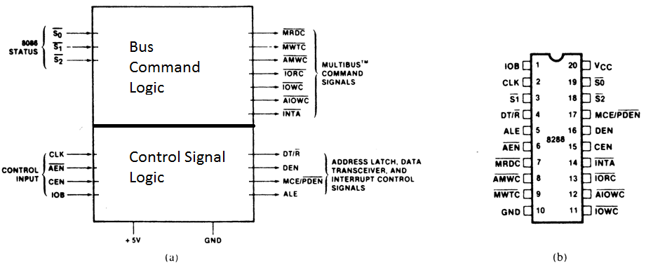
The 8288 Bus Controller
Provides the signals eliminated from the 8086/8088 by the maximum mode operation.
Figure 9–21 The 8288 bus controller; (a) block diagram and (b) pin-out.

Slide 4
IC 8288 Internal Block Diagram
INTA
IORD
IOWR
AIORD
MRD
MWR
AMWR
Status Decoder
Command Signal Generator
S₂
S₁
S₀
CLK
AEN
CEN
IOB
DT/R
DEN
ALE
MCE/PDEN
Control Logic
Control Signal Generator

Slide 5
8288 Bus Controller Pin Functions S₂, S₁, and S₀
Status inputs are connected to the status output pins on 8086/8088:
Status Signals |  |  | Command Signal Generated
S2 | S1 | S0
0 | 0 | 0 | INTA
0 | 0 | 1 | IORD
0 | 1 | 0 | IOWR/AIOWR
0 | 1 | 1 | HALT State
1 | 0 | 0 | OPCODE fetch operation
1 | 0 | 1 | MRD
1 | 1 | 0 | MWR/AMWR
1 | 1 | 1 | Passive

Slide 6
CLK
The clock input provides internal timing.
The CLK output pin of the 8284 signal generator is connected to CLK pin of IC 8288.
ALE
The address latch enable output is used to demultiplex the address/data bus and address/status bus by using Latch IC 8288.

Slide 7
DEN
The data bus enable pin is used to enable the transreceiver IC 8286 which controls the bidirectional data bus in the system.
DT/R
Data transmit/receive signal output to control direction of the bidirectional data bus buffers available in IC 8286.

Slide 8
AEN
If logic 0 is applied to this pin (address enable) then all the control signals gets enabled.
CEN
If logic 1 is applied on this pin (control enable) then all the command signals gets enabled along with control signals with AEN = 0 .

Slide 9
IOB
The I/O bus mode input selects either I/O bus mode or system bus mode operation.
If IOB = 1 then I/O bus mode is selected and PDEN = 0
But if IOB = 0 then system bus mode is selected and MCE = 1

Slide 10
AIOWR
Advanced I/O write is a command output to an advanced I/O write control signal.
IORD
The I/O read command output provides I/O with its read control signal.
IOWR
The I/O write command output provides I/O with its write control signal.

Slide 11
AMWR
Advanced memory write control pin provides memory with an early/advanced write signal.
MWR
The memory write control pin provides memory with its normal write control signal.
MRD
The memory read control pin provides memory with a read control signal.

Slide 12
INTA
The interrupt acknowledge output acknowledges an interrupt request input applied to the INTR pin.
MCE/PDEN
The master cascade enable/peripheral data enable output selects cascade operation for IC 8259PIC if IOB is connected to logic 0 and enables the I/O bus transceivers if IOB is connected to logic 1.

Slide 13
SUMMARY
Minimum mode operation is similar to that of the Intel 8085A microprocessor, whereas maximum mode operation is new and specifically designed for the operation of the 8087 arithmetic coprocessor.
The 8288 bus controller must be used in the maximum mode to provide the control bus signals to the memory and I/O.

Slide 14
This is because the maximum mode operation of the 8086/8088 removes some of the system's control signal lines in favor of control signals for the coprocessors.
The 8288 bus controller reconstructs these removed control signals.

